Slide 1
Water System Design
Table 3: Project 1
group menber: Xulin Yang, Jianrong He, Kaijian Zheng， Zimo Wang, Robert , Catherine

Slide 2
The Challenge
To provide a sustainable, simple, and safe drinking water system for a remote community with a population of 2000 over the course of 10 years.

Slide 3
Constraints Factors to Consider
System needs to last and support the town’s population for a minimum of 10 years
Tank must be placed on top of a 10m high structure
The land must hold up the weight.
Costs
Size
Simplicity (for repairing)
Safety
How long it will last

Slide 4
Background Information
How we approached each of the modules in the design project:
Modelling for empirical coefficients using the experimental rig
Creating a model using relevant equations
Combining theory and empirical data to generate models for our design
Solving model using differential equations in MATLAB

Slide 5
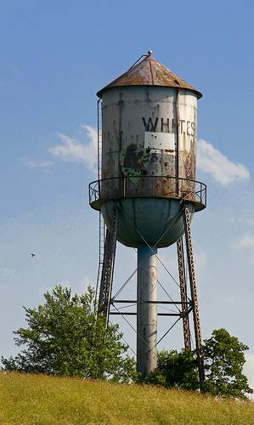
Water Tank
Module 1

Slide 6
Water Tank: Approach
Using the Engineering Bernoulli Equation, we obtained a model for tank drainage.
To confirm our model, we modelled tank drainage in similar conditions on an experimental rig during the engineering workshops.
This allowed us to obtain an empirical model for Cd, and observe (on a smaller scale) how our tank would drain.
From there, we decided on the parameters for our tank design based on the requirements of the community.

Slide 7
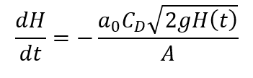
Water Tank: Background Information
Differential equation for the height of water in a draining tank is:
All variables are known except for the drainage coefficient, Cd.
Empirical data from the experimental rig was used to obtain this coefficient.

Slide 8
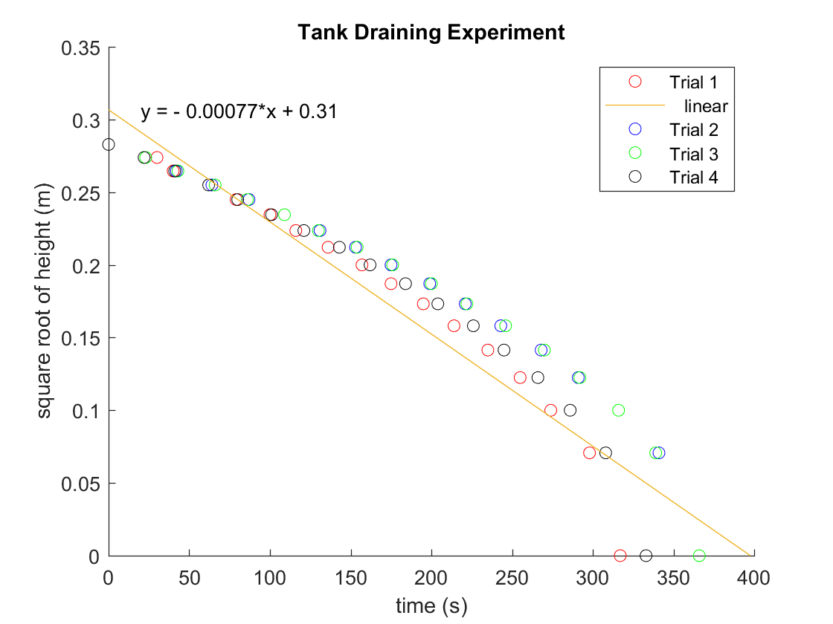
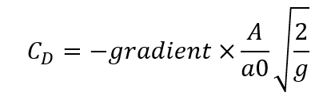
Water Tank: Modelling Rig Drainage to find Cd
From linear fittings of the 4 trials and using the equation
to solve for Cd, we obtained a drainage coefficient close to
0.8

Slide 9
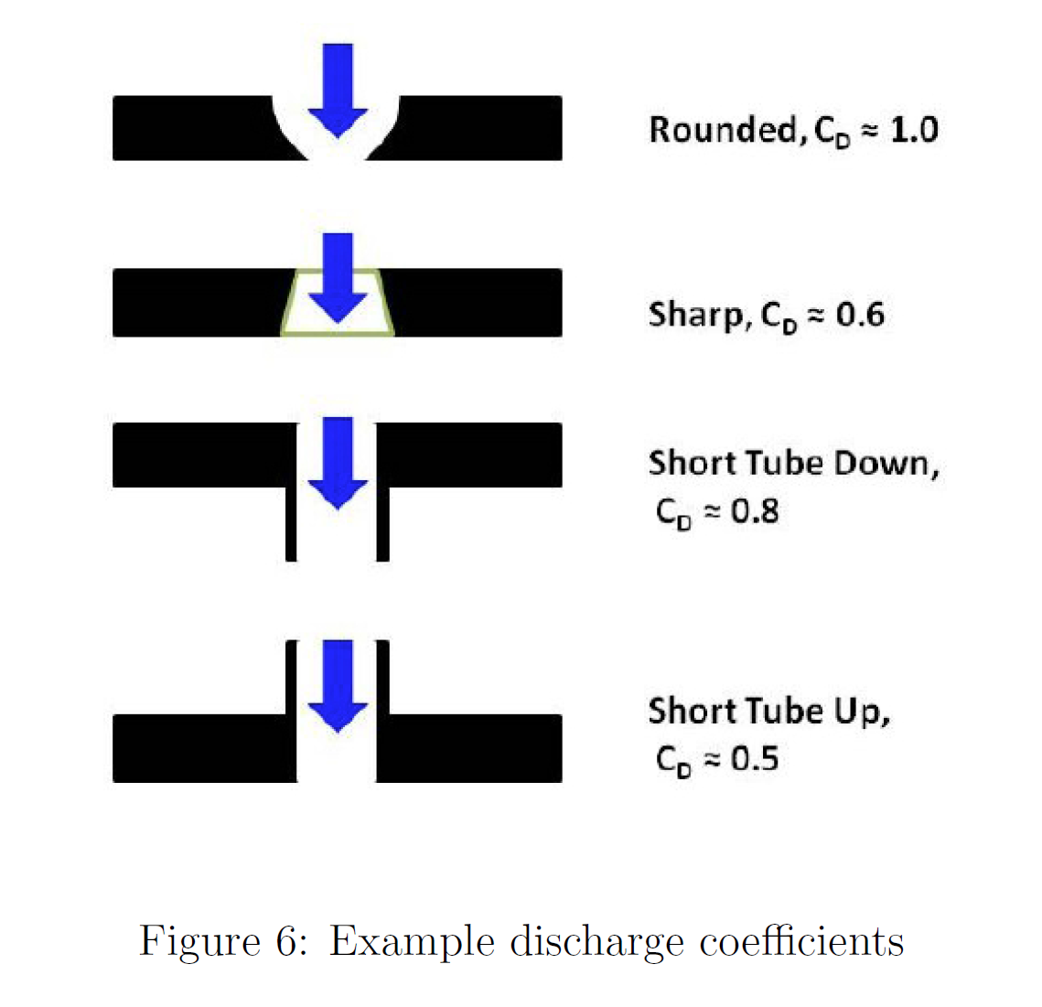
Orifice

Slide 10
Material
Material: Galvanised steel with PE material on the surface
not only steel for price and weight (PE is about 35% cheaper)
not only PE for strongness and toughness
if we use steel inside a PE cover, the water will be rusted and the water treatment cannot get rid of the iron in the water
why not other material?

Slide 11
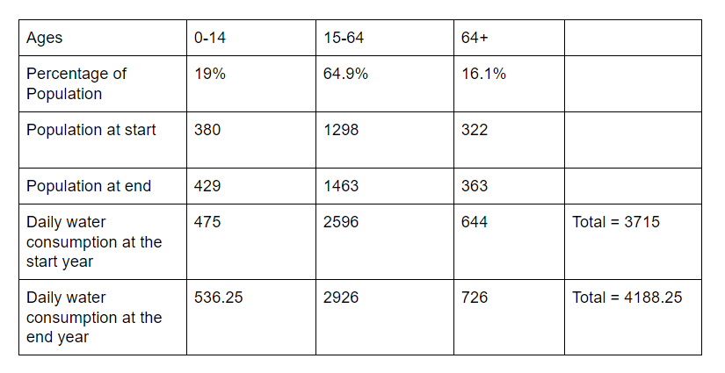
Water Tank: Design
2000*(1+0.012)^10=2253.383556=2254 (2254 people in the end)
According to the information from the Statistics Australia:
The tank must keep at least 4200L in the whole system.

Slide 12
Shape and Dimension
Tank Shape: Cylinder
A cylinder has the smallest surface area of any prism, so we decided on a cylindrical tank to save on material costs.
For cylinder, the surface pressure on the side-wall is the same.
 | Tank 1 | Tank 2 | Tank 3
Height (m) | 3 | 3 | 3
R (m) | 4.6 | 3.3 | 5.6
Size (m^3) | 200 | 100 | 300

Slide 13
Water Tank: Design
Design for meeting the demand of drinking water,
assume sleep 8 hours, 16 hour need to drink
0.125l/h = 0.00007 m^3/s
design flow out rate 0.0001 m^3/s = 0.00000151 m/s
Provide at least this value of water
flow in rate Q = 0.001 m^3/s = 0.00001505 m/s (Q/A)
(explained by pump group)

Slide 14
Water Tank: Design
sensor location:
(As we do not know the time taken by the other processes:)
due to hysteresis, we put higher sensor at 0.3 to the top
0.3
Design H(high sensor) - H(low sensor) = 2 m
Then:
t(only out) = 15.3 days
t(in and out) = 1.7 days
HIGHER
2
0.7
LOWER

Slide 15
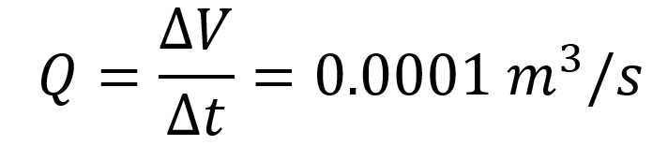
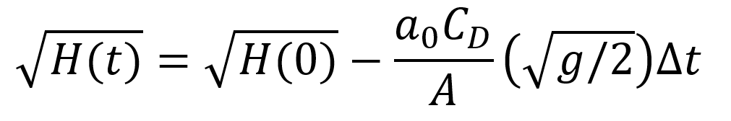
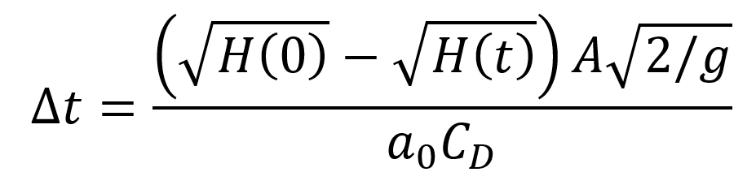
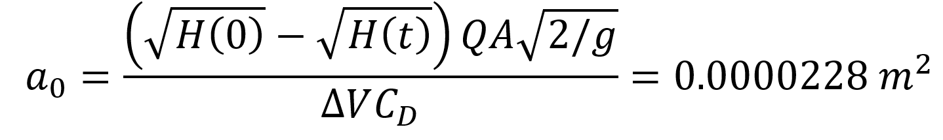
Water Tank: Design
Calculating orifice size from desired outflow rate:
Since:
Using model for the height of fluid in the tank at time t:
Rearranging for t gives:
Substituting t = QV, rearranging and solving:
Solving for radius gives orifice radius of 0.27 cm

Slide 16
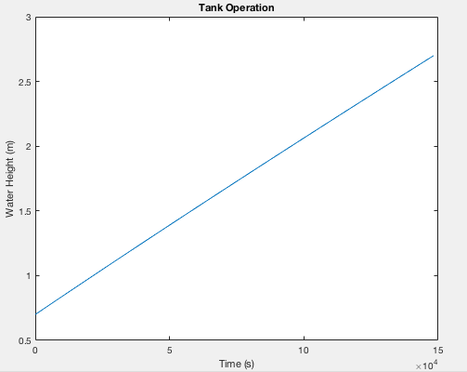
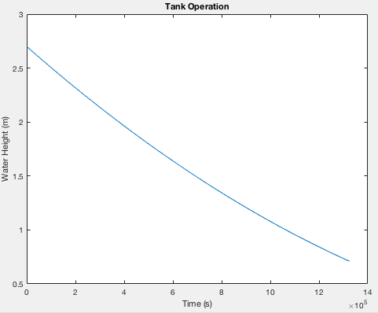
Water Tank: Model Tank operation
flow out with pump in
dhdt = Q/A - (a0/A)*sqrt(2*g*h)
flow out only
dhdt = - (a0/A)*sqrt(2*g*h)

Slide 17
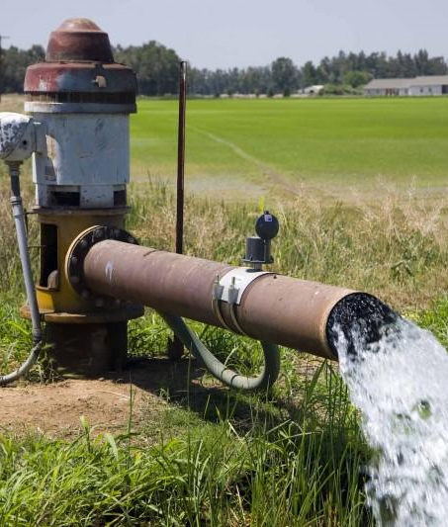
Pump and Pipe System
Module 2

Slide 18
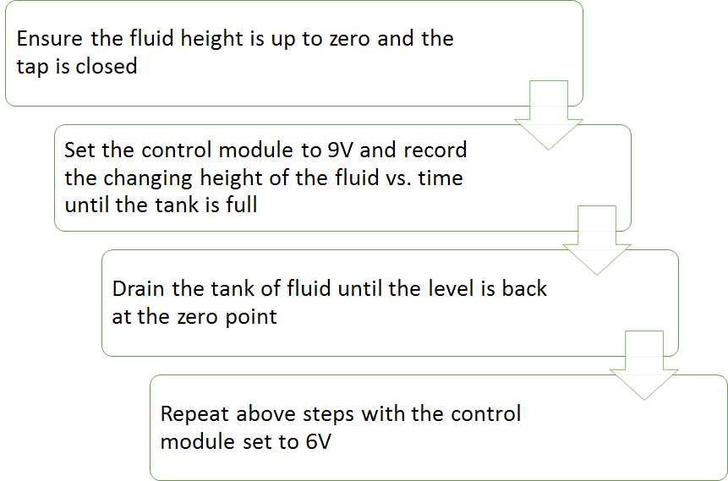
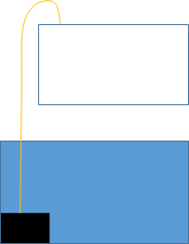
Flow Rate Q:
description of the experimental procedure
PUMP 9V/6V
Notes:
the first experiment we do with pump is to determinate the flow rate Q. for this experiment, we need ensure the fluid height is up to 0 and the beginning and the tap is closed. we try both 9v and 6v of control module and record the changing height of the fluid vs time until the tank is full.

Slide 19
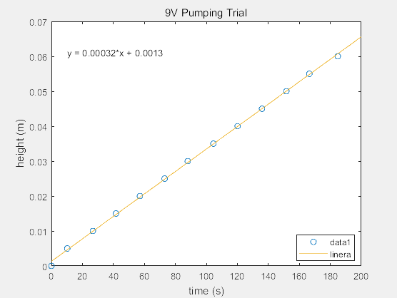
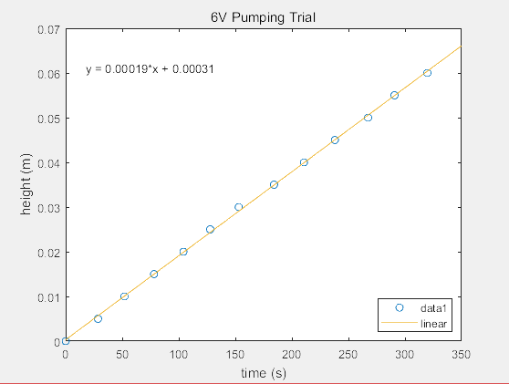
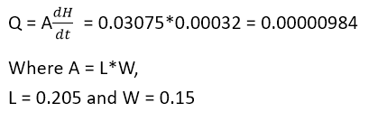
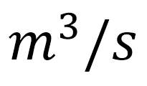
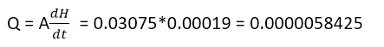
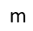
Notes:
then we put the data in matlab to sketch the graph. the data is represented by the dot and we found the best fit linear equation. as the graph shown, we have seen that 9v pumping has greater gradient than 6v pumping. According to the formula Q=a dhdt, we can find out both flow rate q of pump in different situation. the flow rate of 9v pumping is …… and 6v pump is …...

Slide 20
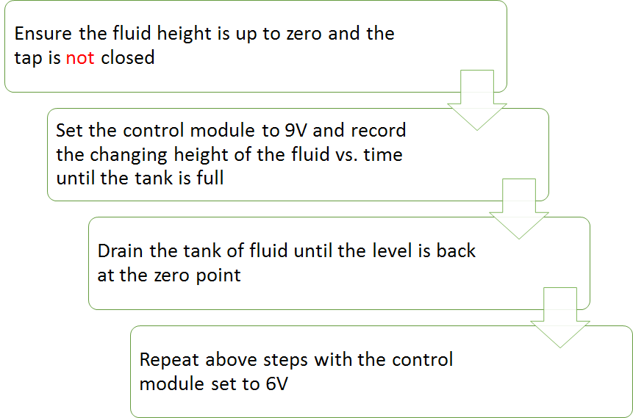
Description of the experimental procedure
PUMP 9V/6V
Notes:
the second experiment we did with pump is similar with the previous, we still record the changing height vs time, but with opened tap.

Slide 21
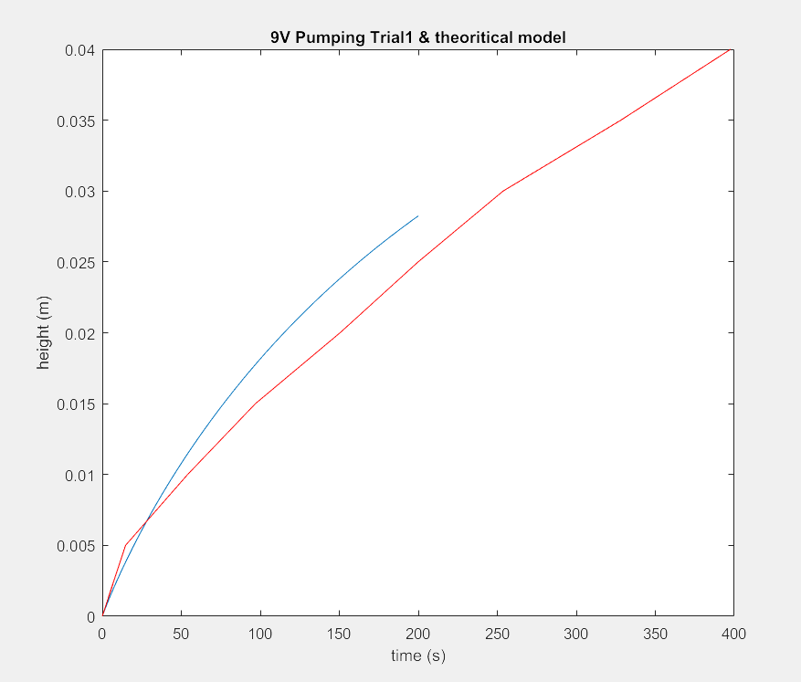
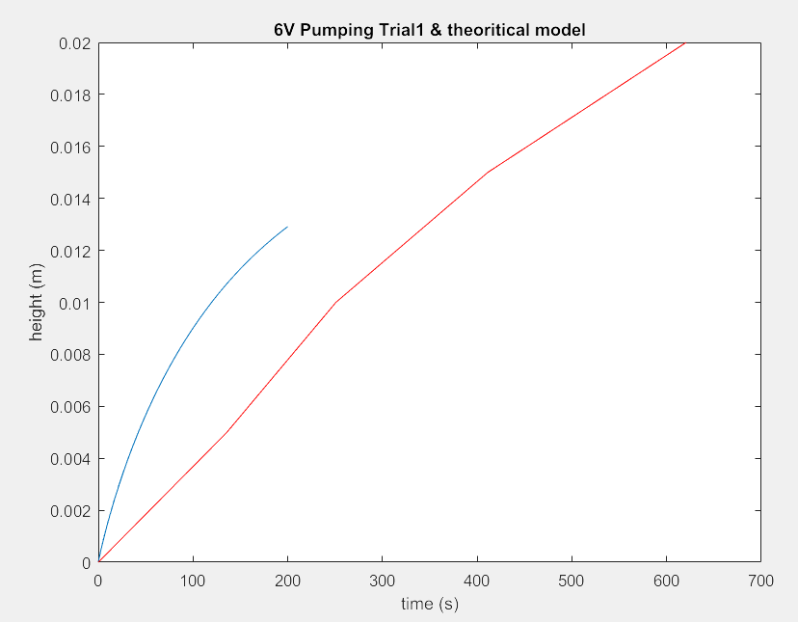

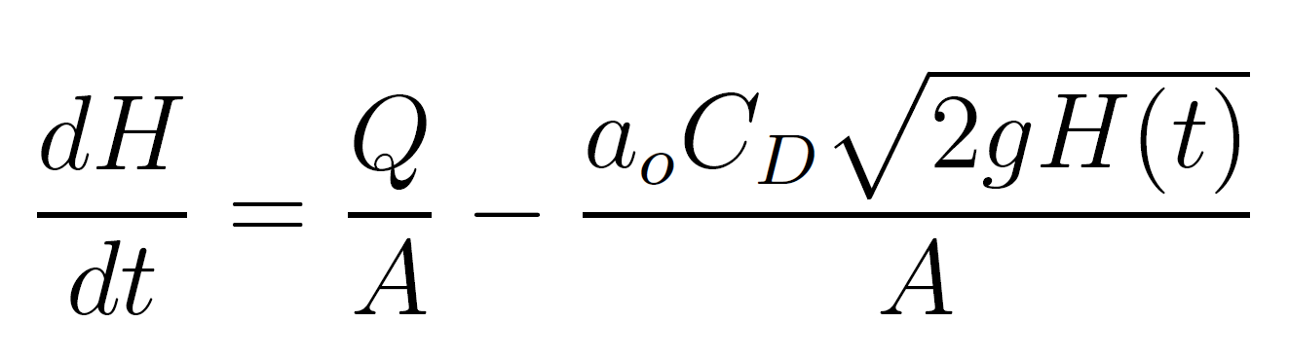
relationship of the height of a fluid draining from a uniform cross sectional tank vs. time with constant inflow rate:
Notes:
we plot our experimental data in matlab and shown as red line. also we plot the dhdt which is theoretical. we found that two curve is quite matched????

Slide 22
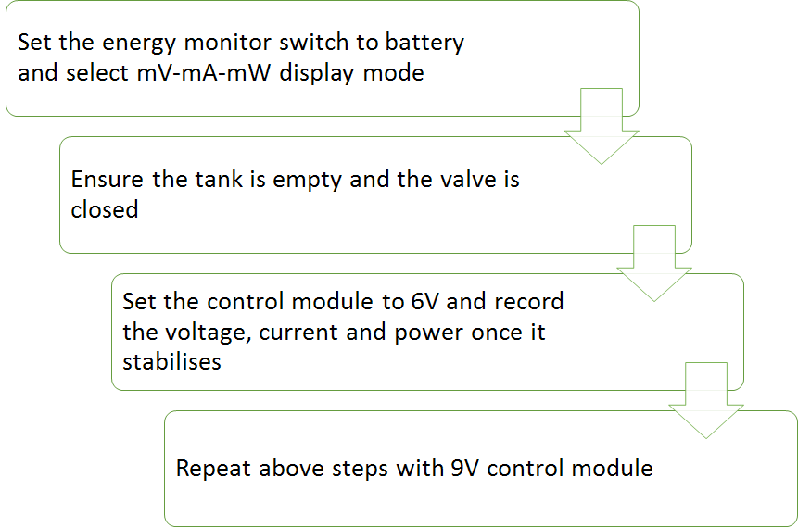
Measure pump power
mV mA mW
PUMP 9V/6V

Slide 23
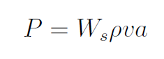
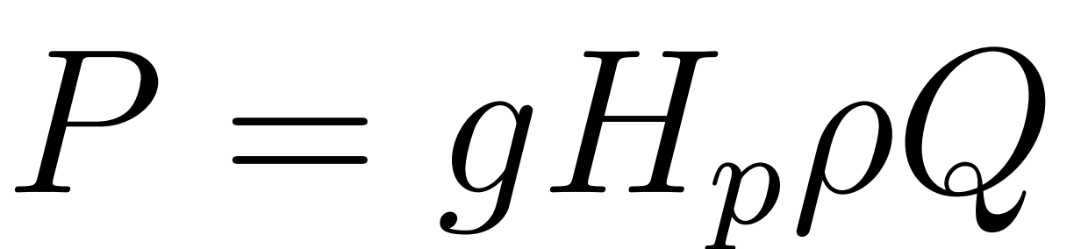
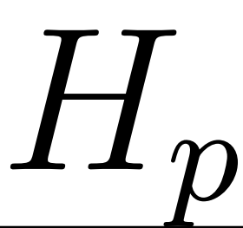
result
Supply Voltage (V) | Voltage (mV) | Current(mA) | Power(mW)
6.0 | 6275 | 229 | 1437
9.0 | 8782 | 385 | 3381
the power of a pump can be expressed as:
when use 6V supply voltage: we have 25m
when use 9V supply voltage: we have 35m

Slide 24
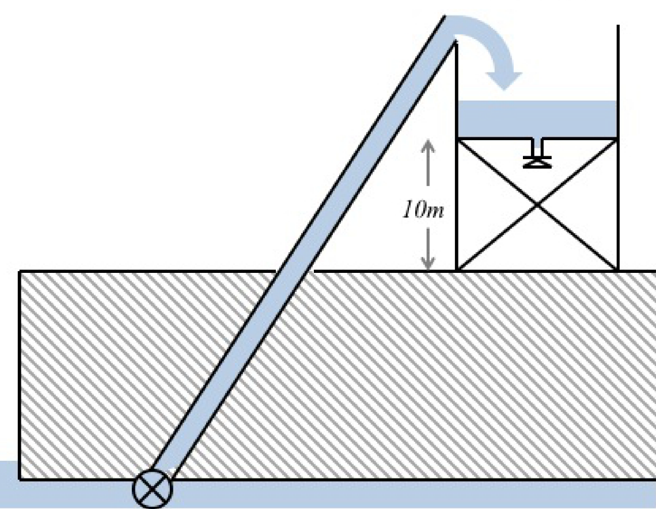
For design
Q=0.001
Time to Fill: 55.6h
Flow Rate Q: 0.001
Specific work Ws: 48g = 470.4 J
Expected power: 3623.65 W
Time to fill the tank if empty: 55.6 hrs
P=3624W

Slide 25
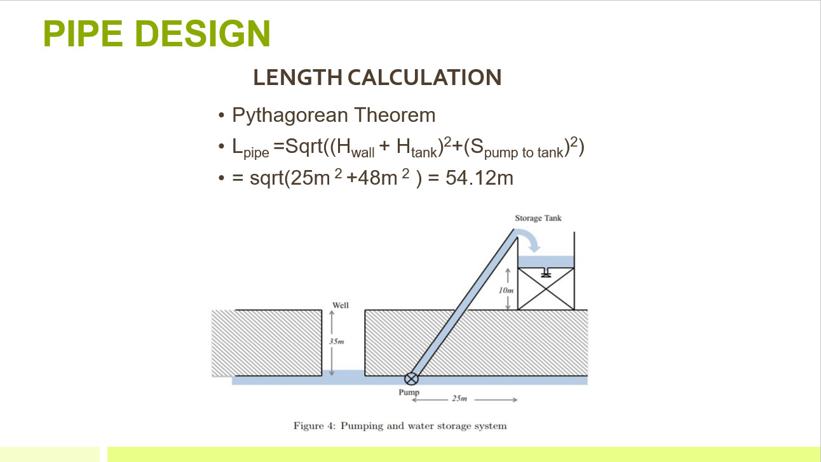

Slide 26
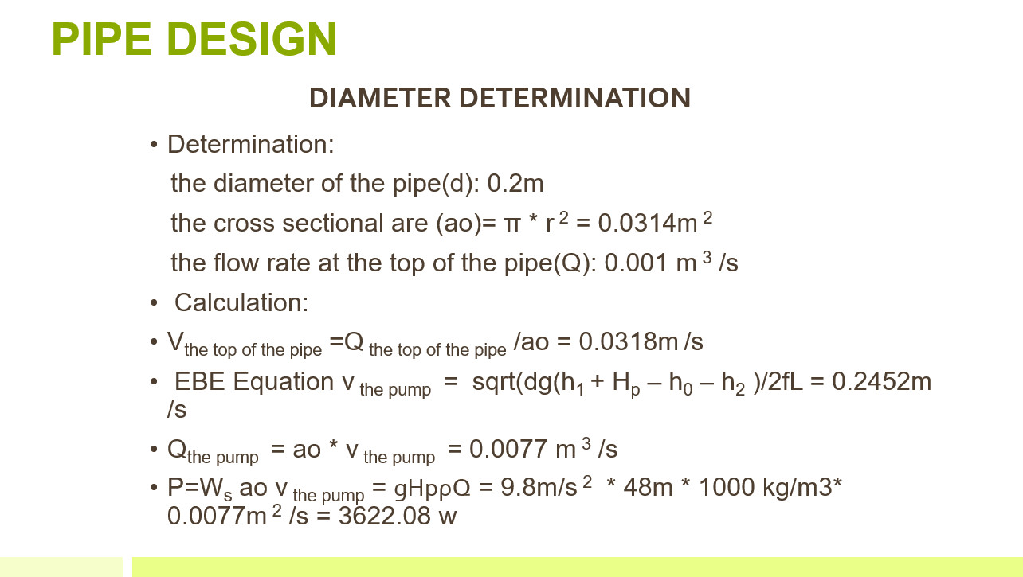

Slide 27
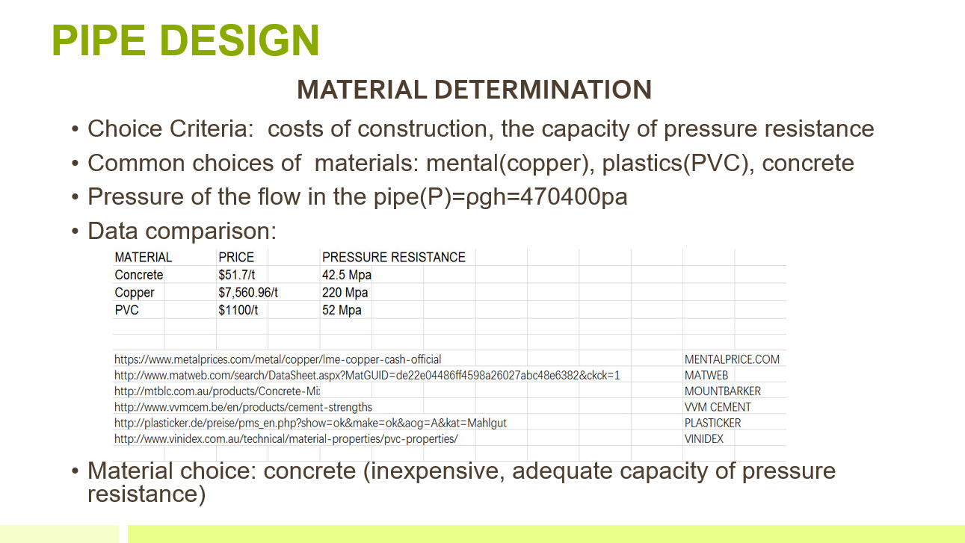

Slide 28
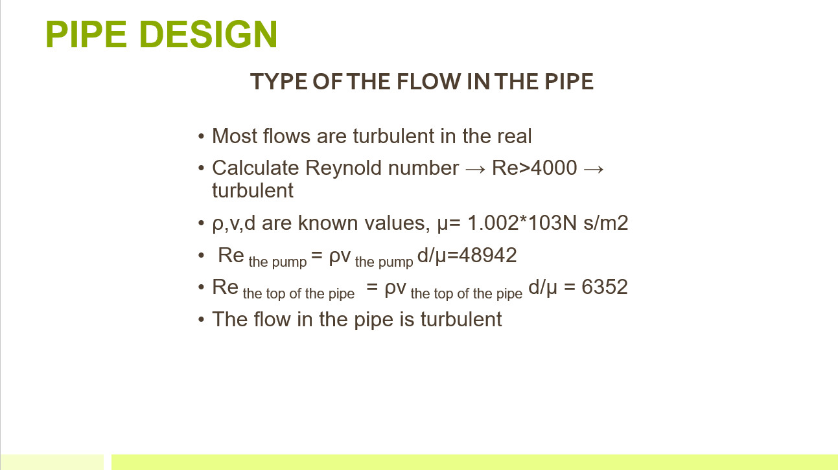

Slide 29
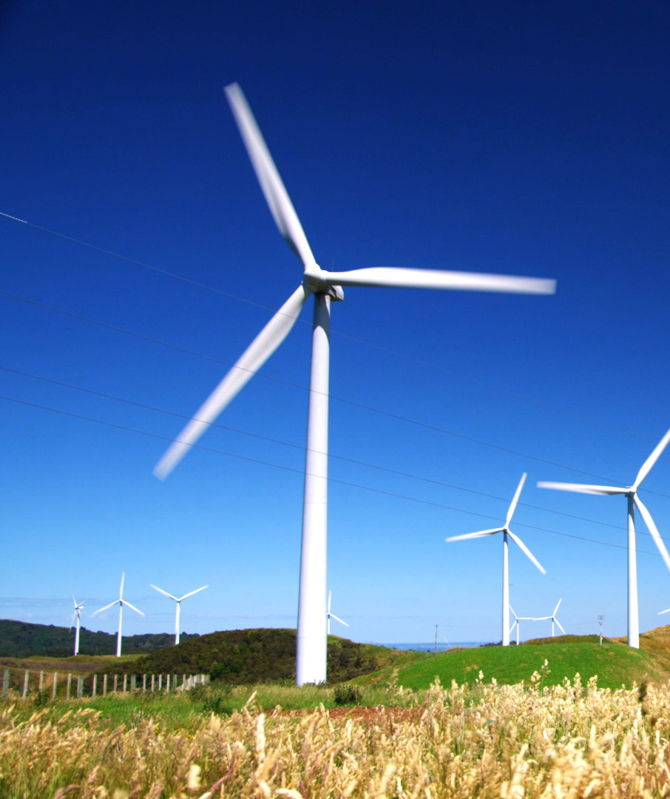
Wind Turbine
Module 3

Slide 30
Our Approach
Performed an experiment using wind turbine blades to measure the pitch angle (beta) and tip speed ratio (lambda) that would yield the optimal power coefficient (Cp) for the blades.
Designed a set of 3D printed custom blades based on research
Calculated the scaled up radius of the blades based on the maximum Cp from the experiment and the power requirements of the pump.

Slide 31
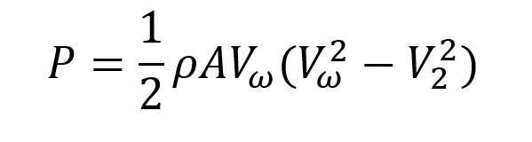
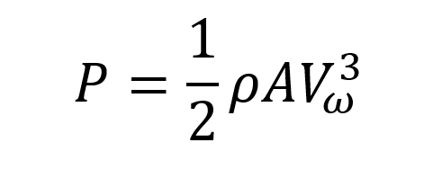
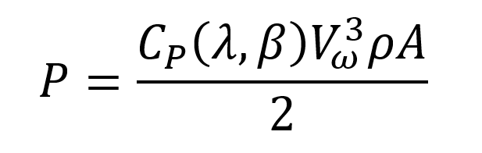
Background Information & Objective
Power produced in the ideal situation where all the wind’s energy is transferred to the wind turbine and the wind speed behind the turbine is 0m/s:
The power coefficient variable Cp is introduced to account for the losses in power. It is determined empirically for each blade design and is dependent on the pitch angle and tip speed ratio of the blades.

Slide 32
Experiment Procedure
Ensure the wind turbine is facing the fan directly and that the fan is blowing perpendicular to the wind turbine
Measure wind speed at wind turbine and record power and RPM Repeat steps for different wind speeds and pitch angles
mW
RPM

Slide 33
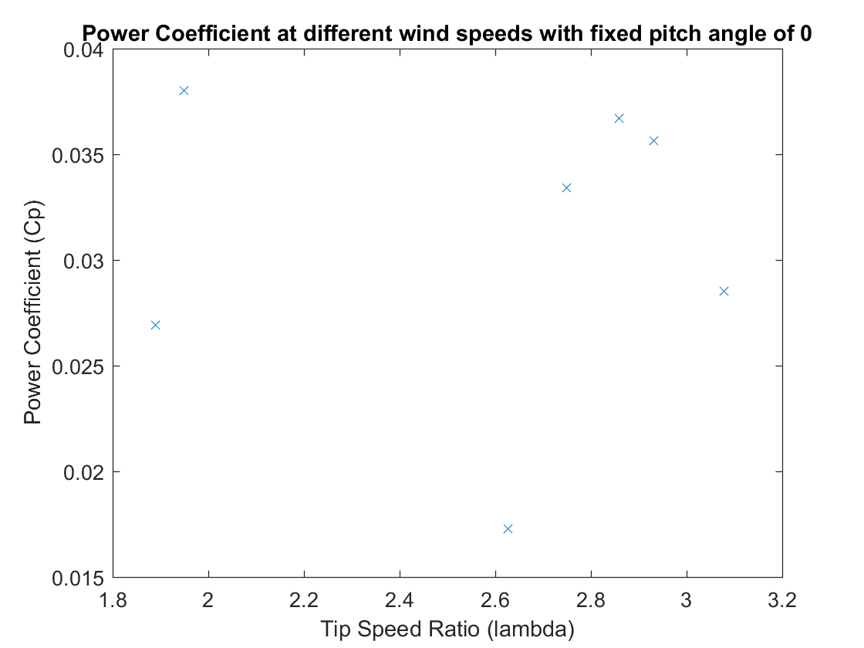
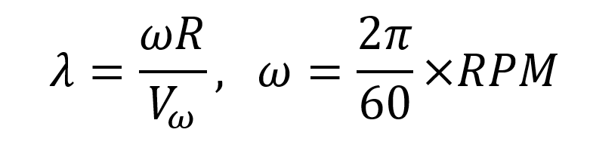
Measuring Cp while varying tip speed ratio
Tip speed ratio was calculated using the RPM measurements obtained during the experiment, using the equation:

Slide 34
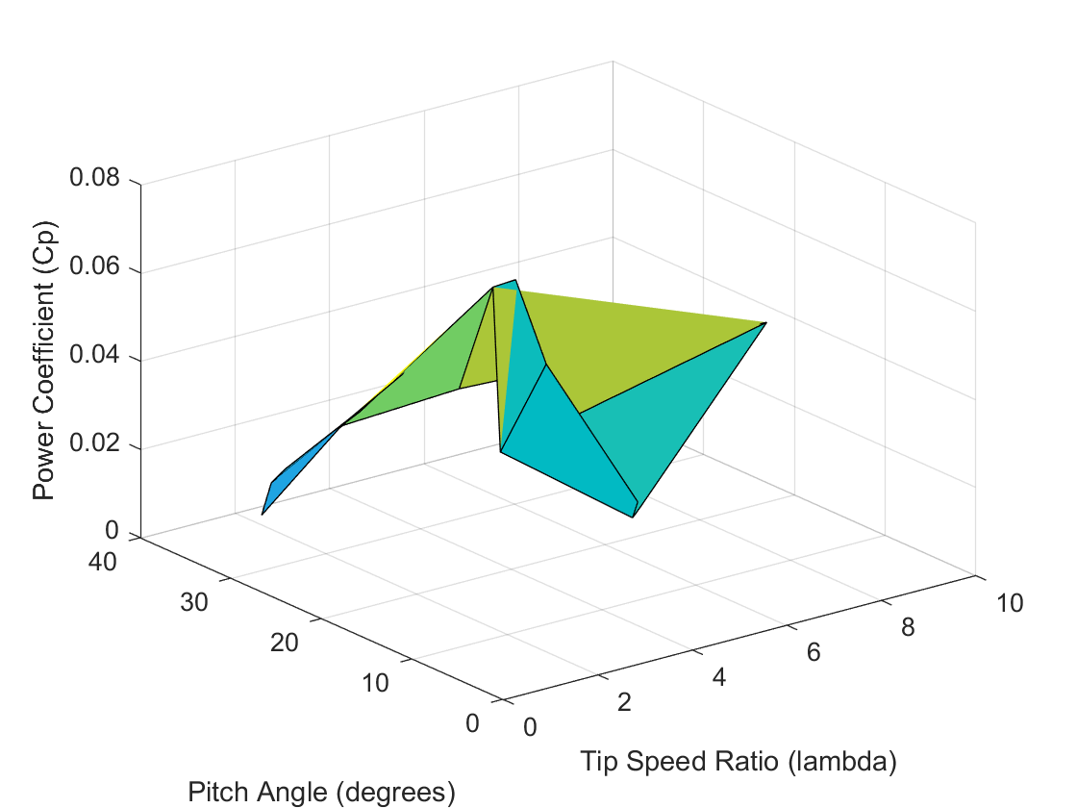
Maximum Cp from all pitch angle and tip speed ratio combinations
Maximum Cp occurred at a pitch angle of 20 degrees and a tip speed ratio of approx. 4.11.
This value was chosen for our design and used in further calculations.

Slide 35
Wind Turbine: Blade Design
Radius: 13.5m
Pitch Angle: 20 Degrees
RPM: approx 16
Power Produced: 3753 W
Assumptions
That there are no structures or features in the surrounding landscape that will block wind from approaching the turbine.

Slide 36
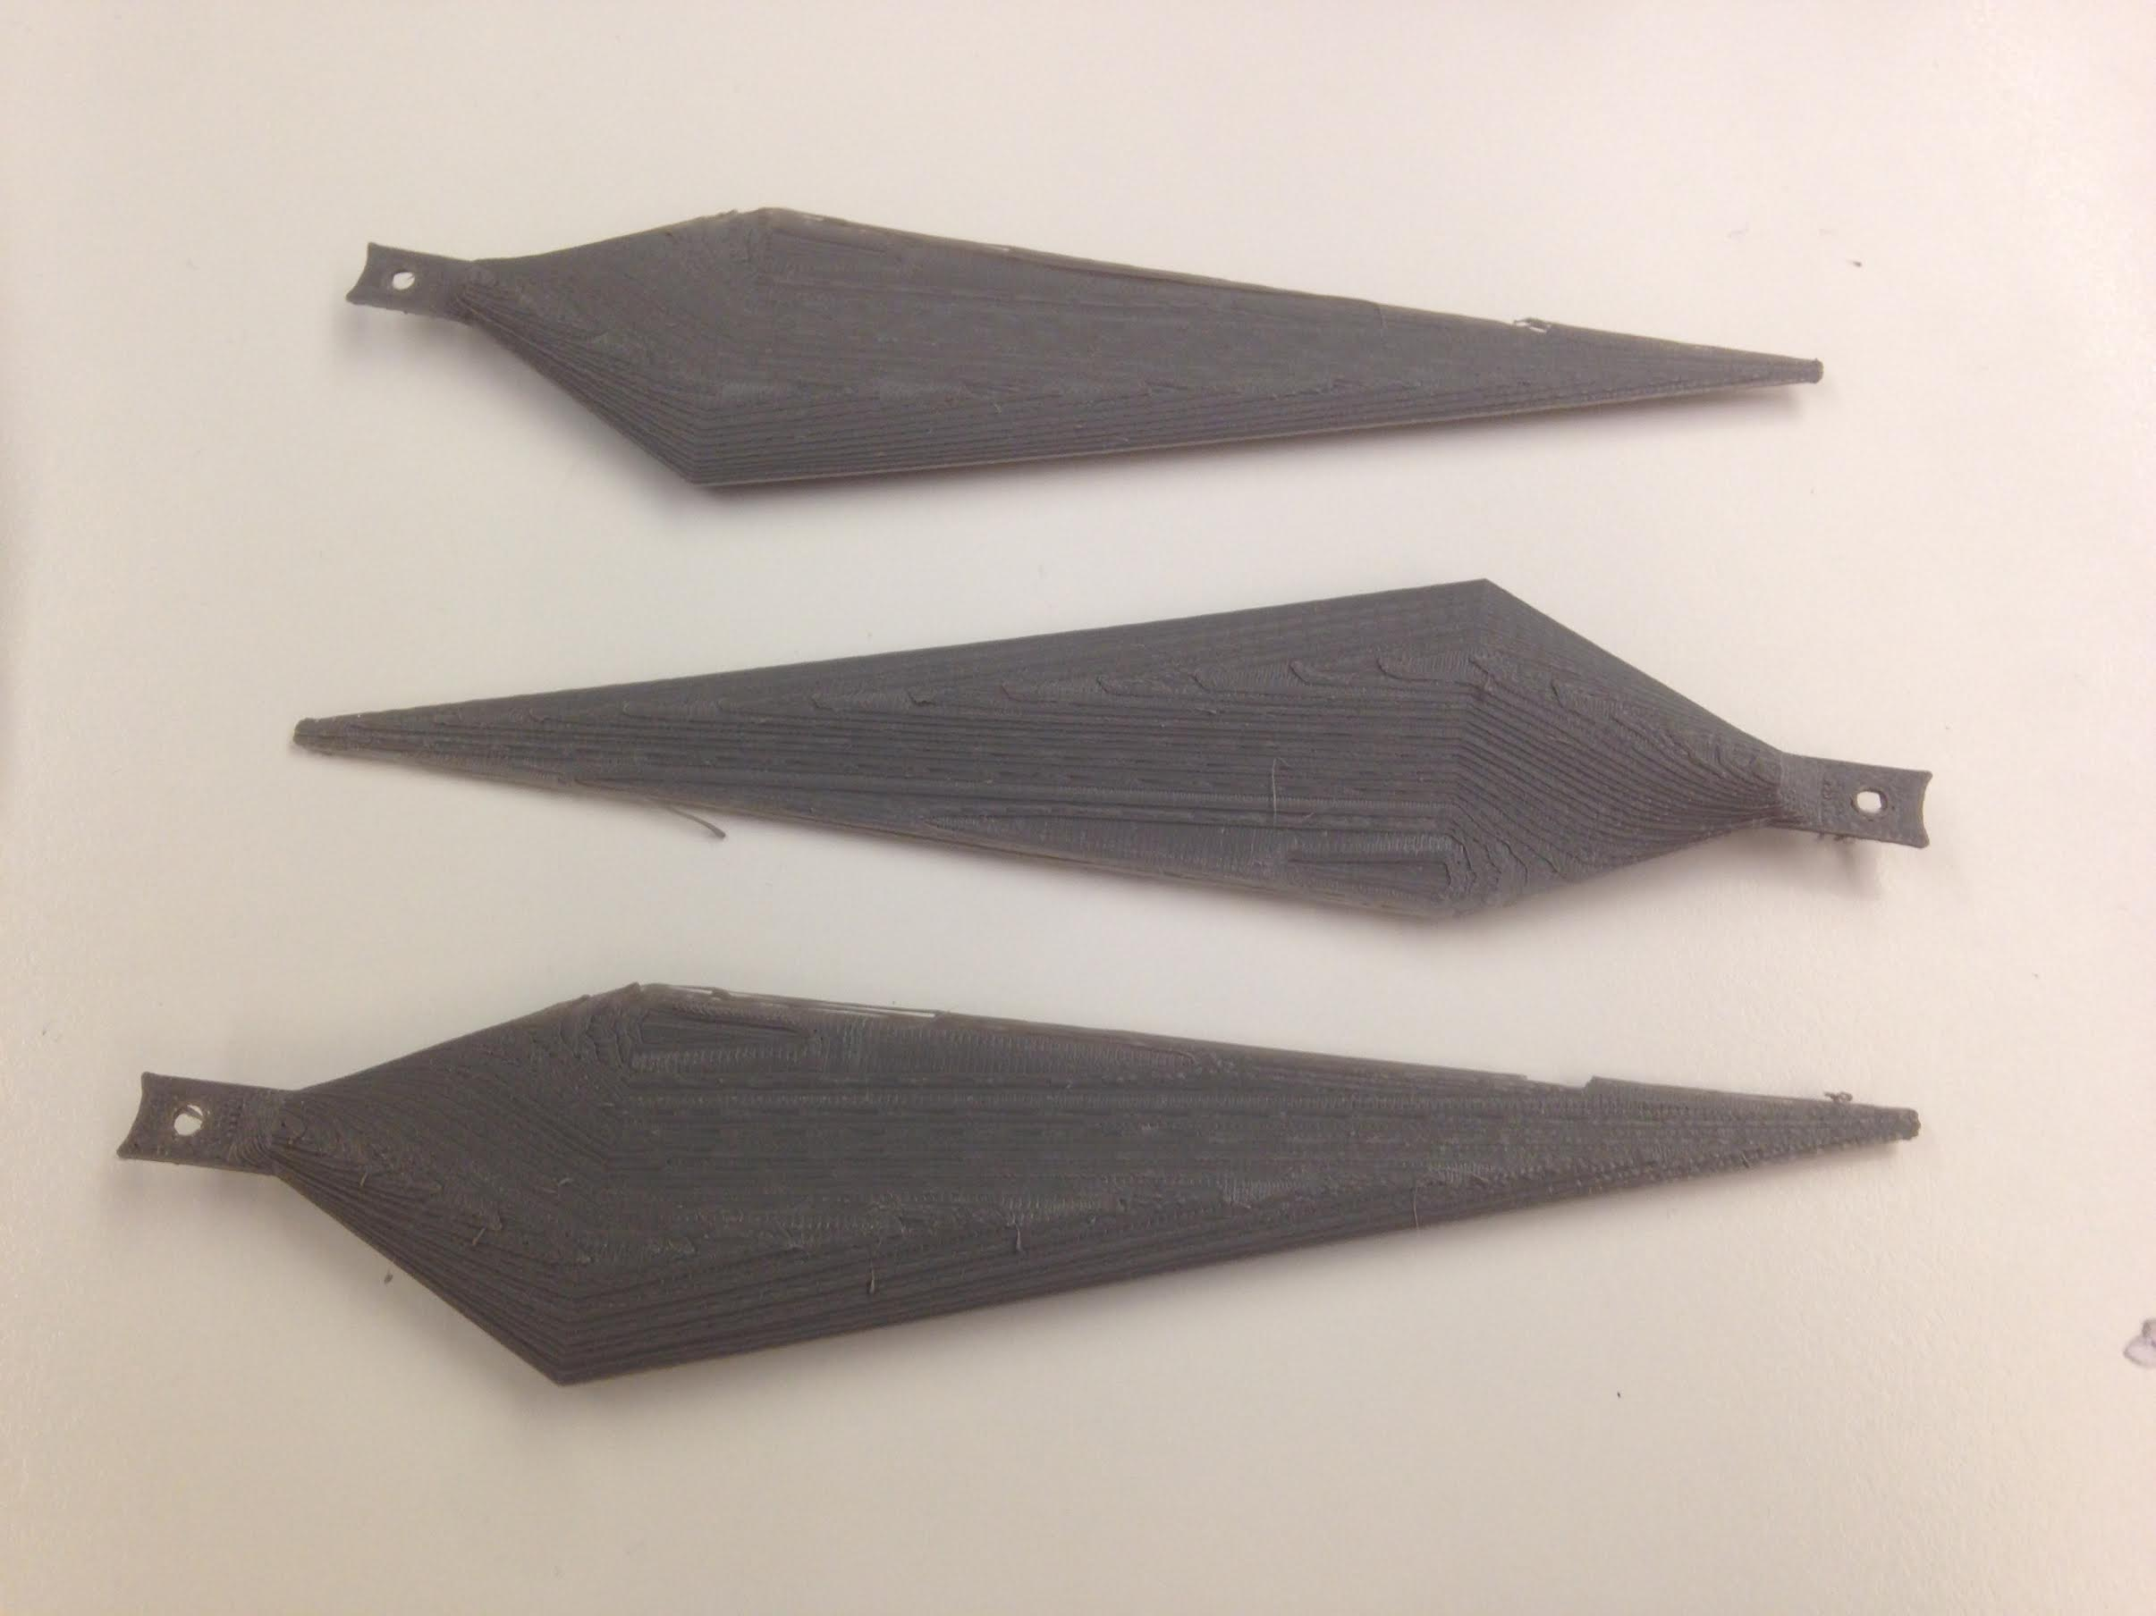
Wind Turbine: 3D Blade Design
Custom 3D blade design was created based on research and the workshop tutorials. Its radius is 16.6 cm
Our final design has not yet been finalised.
1 cm
1:81.82

Slide 37
Conclusion

Slide 38
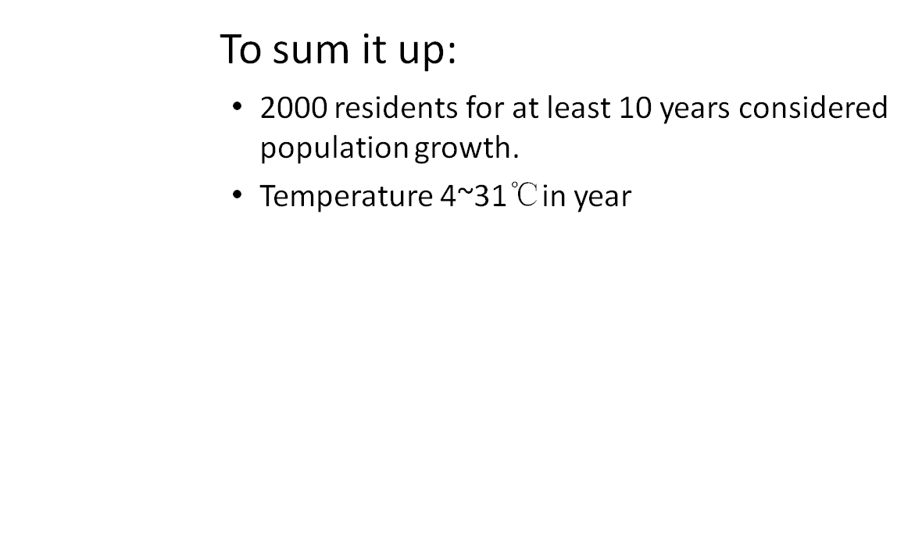
To Conclude...

Slide 39
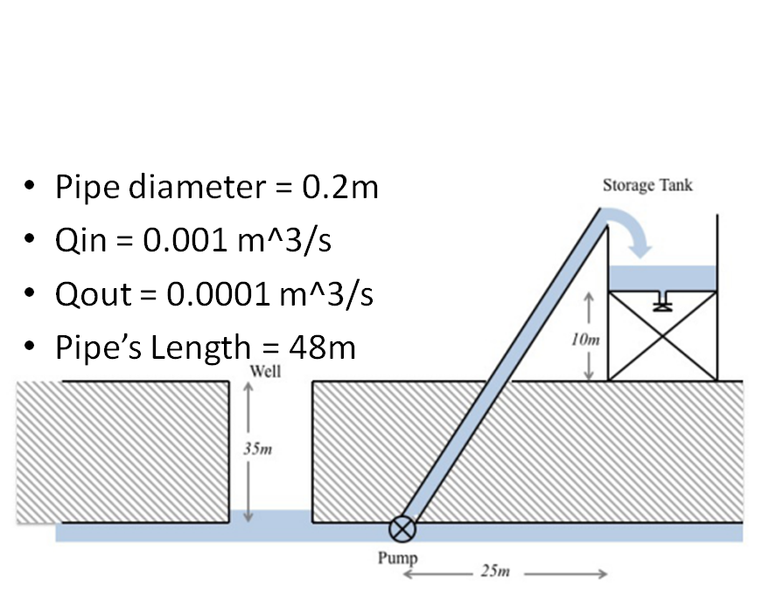

Slide 40
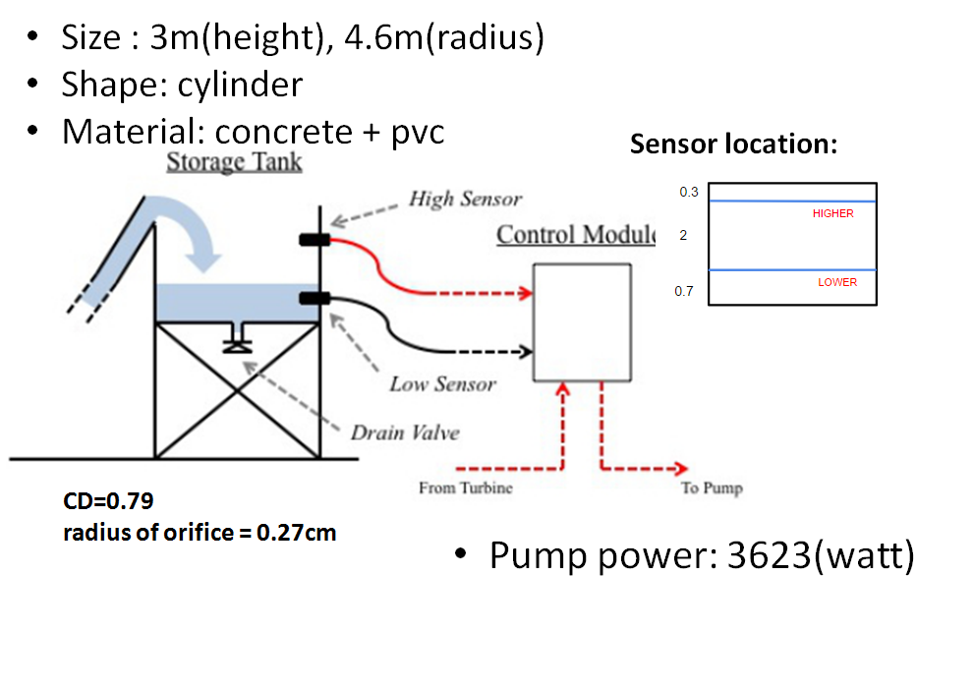

Slide 41
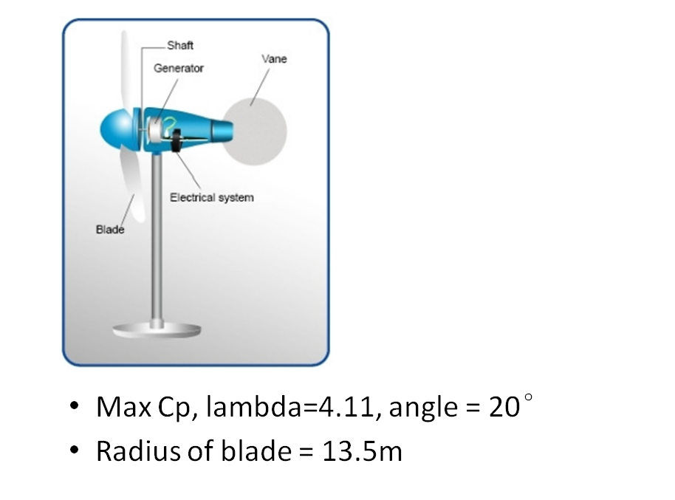

Slide 42
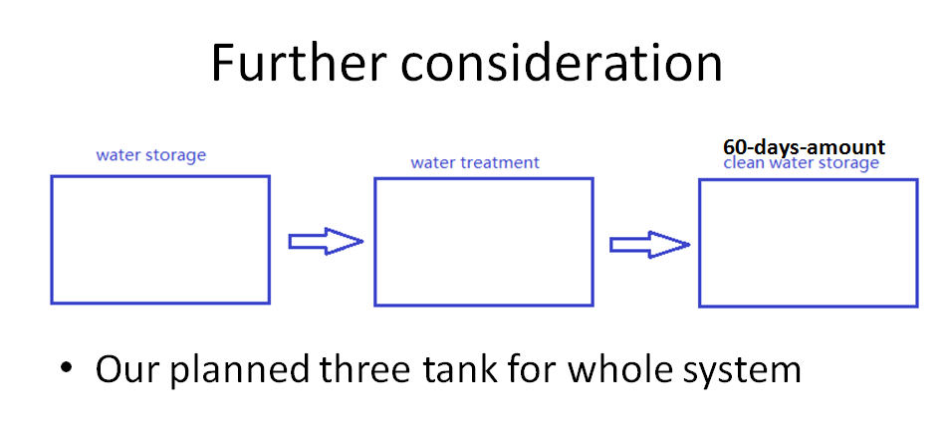
Plan B

Slide 43
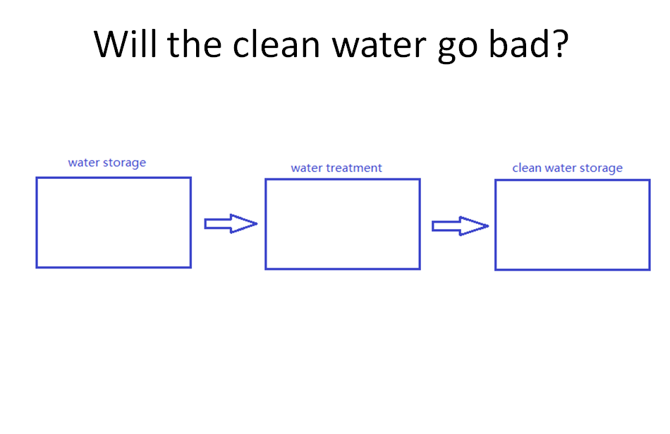

Slide 44
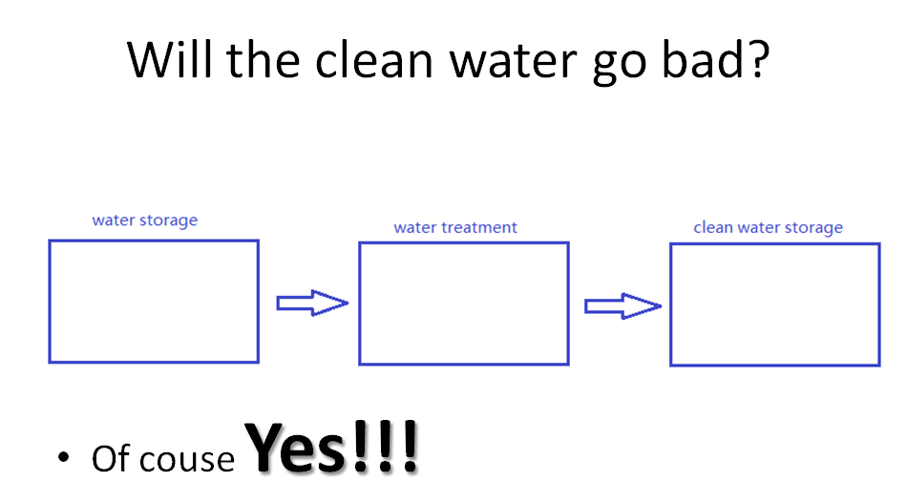

Slide 45
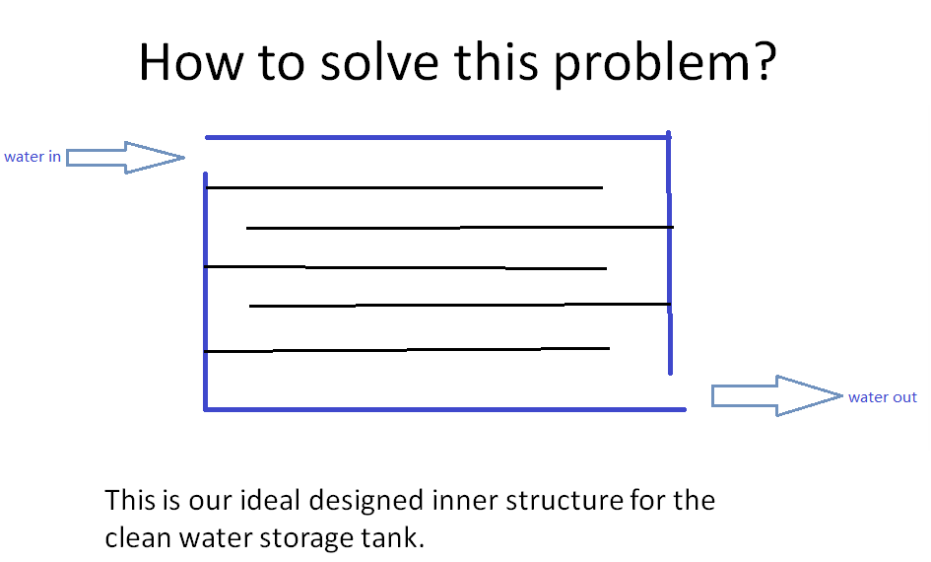

Slide 46


Slide 47
Bibliography
water consumption rate: http://www.abs.gov.auhttps://www.metalprices.com/metal/copper/lme-copper-cash-official
http://www.matweb.com/search/DataSheet.aspx?MatGUID=de22e04486ff4598a26027abc48e6382&ckck=1
http://mtblc.com.au/products/Concrete-Mix.html
http://www.vvmcem.be/en/products/cement-strengths
http://plasticker.de/preise/pms_en.php?show=ok&make=ok&aog=A&kat=Mahlgut
http://www.vinidex.com.au/technical/material-properties/pvc-properties/
http://www.engineeringtoolbox.com/water-dynamic-kinematic-viscosity-d_596.html

Slide 48
Thanks for listening
Q&A
group menber: Xulin Yang, Jianrong He, Kaijian Zheng, Robert , Catherine
--Table 3

